Slide 1

Flowback Summary Workflow
June 2024

Slide 2
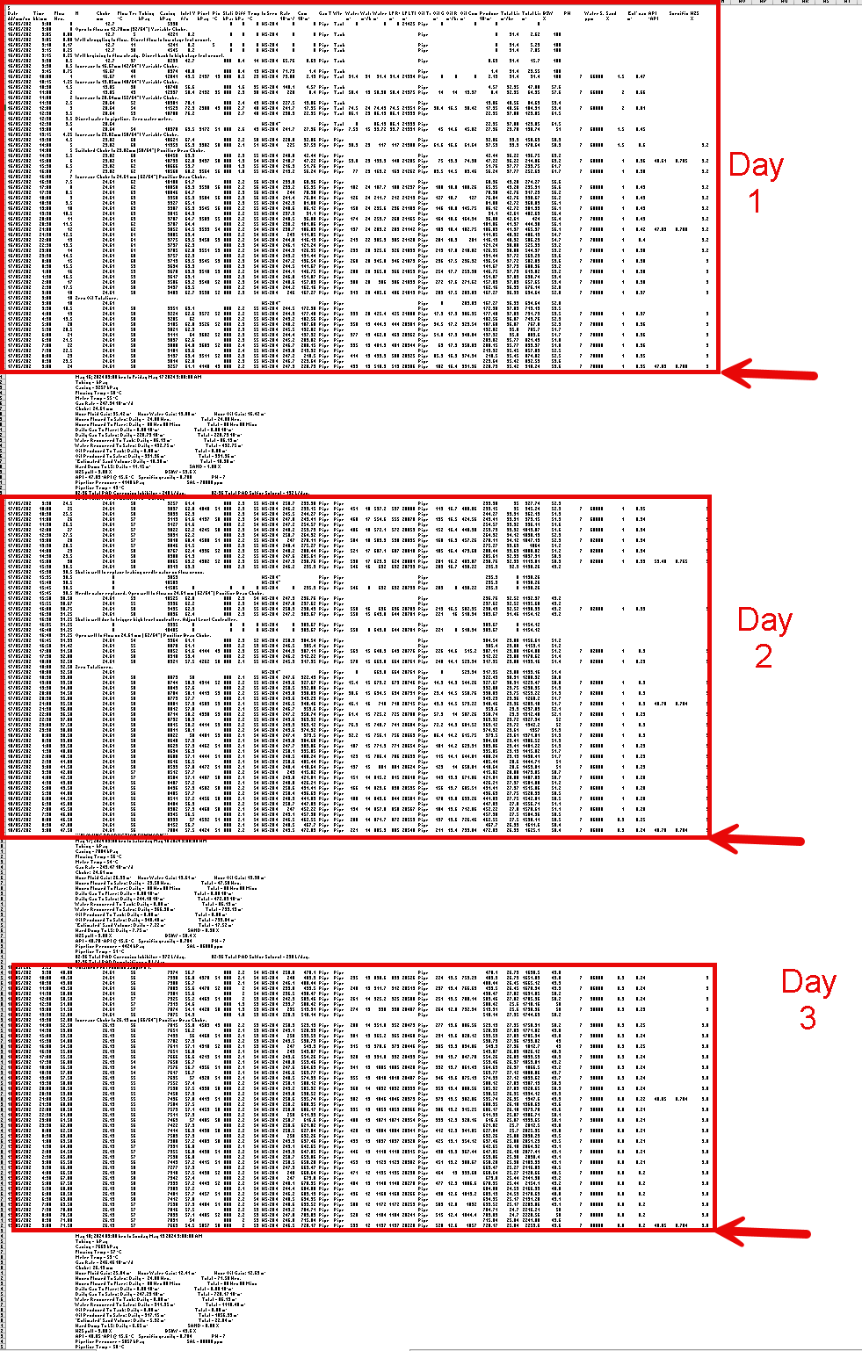
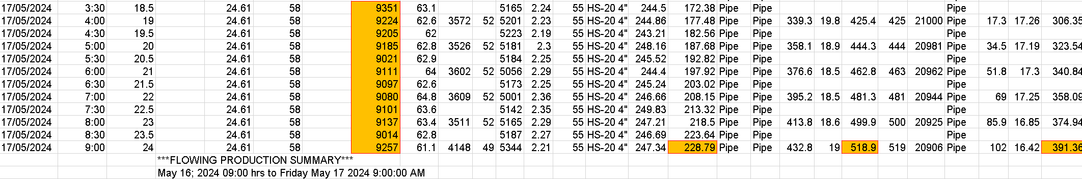
Input & Script Overview
Columns Of Interest:
Casing (Pressure)
Cumulative Gas
Cumulative Water
Cumulative Oil
High-level Script Overview:
Extract cumulative values at the record time
Subtract previous days cumulative value
Average all casing pressure recordings throughout the day
2-36 A-Well

Slide 3
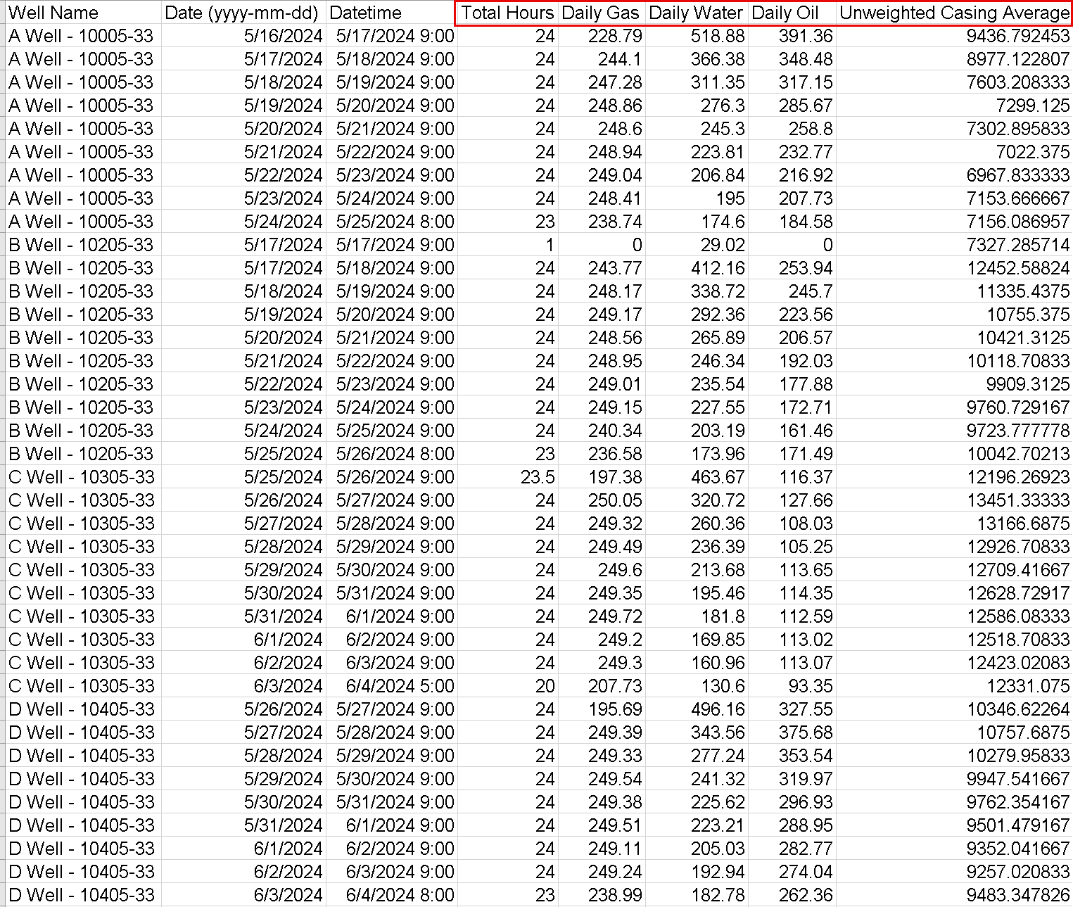
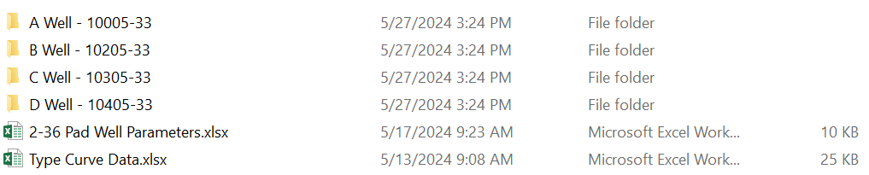
Output
Total Hours, Daily Gas, Daily Water, Daily Oil, Casing Average
Multi-Well Data Input
2-36 Directory Input
2-36 Pad Output CSV

Slide 4
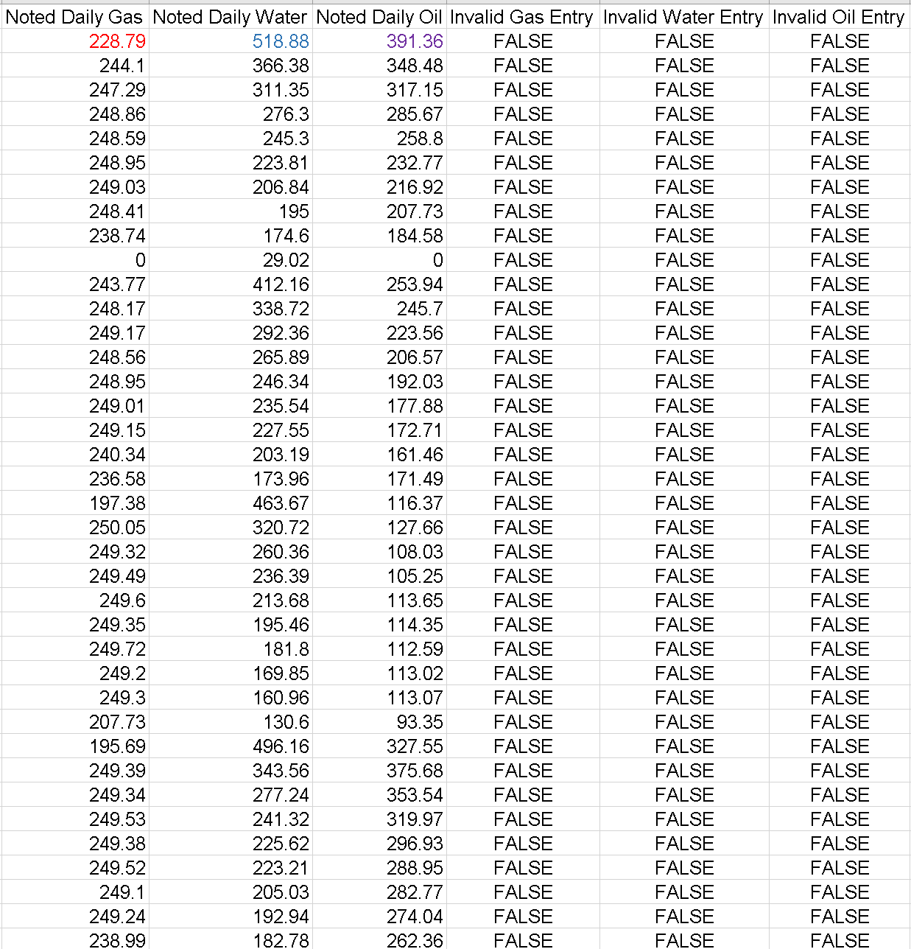
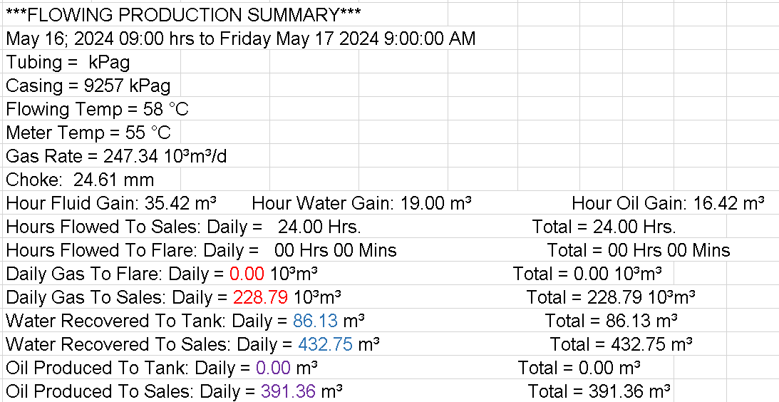
Operator Comparison
2-36 Comparison Output
Extract Values in Production Summary
Compare Noted vs Calculated Values for Error
Determine Invalid Entries with Percent Error > 2%
2-36 Day 1 Operator Summary

Slide 5
Workflow Summary
Input well flowback CSV or multi-well directory
Extract daily cumulative values & casing pressure recordings
Calculate daily values by subtracting previous days cumulative recordings
Average casing pressures by day
Compare calculated values to noted operator values
Output to CSV

